Slide 1
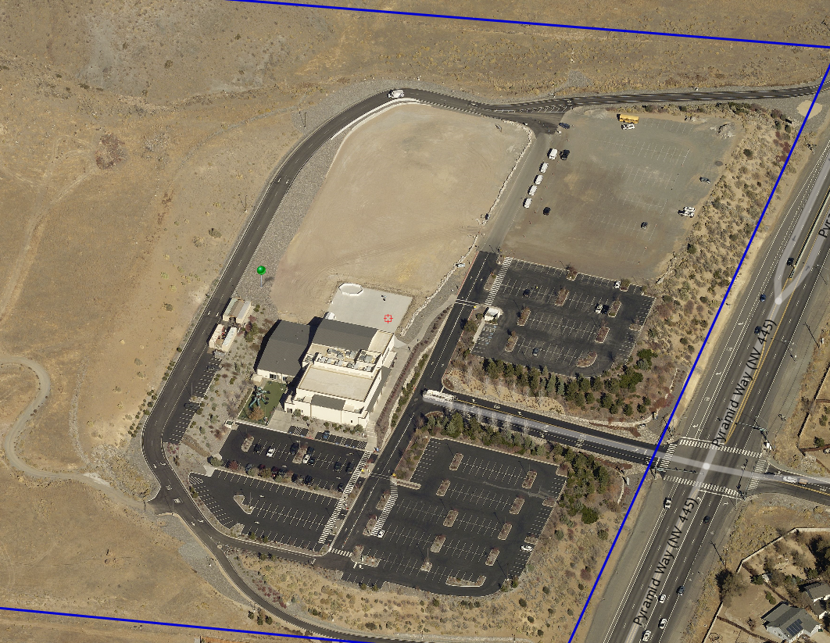
WSUP19-0029 Summit Christian Church
Washoe County Board of Adjustment
April 16, 2020

Slide 2
Request
This is a request for grading and expanding the use of religious assembly on the property, which requires a special use permit (SUP) per Washoe County Code 110.438.35(a)(4) for grading and per Table 110.302.05.2 for religious assembly
This case has been delayed since February for various reasons

Slide 3
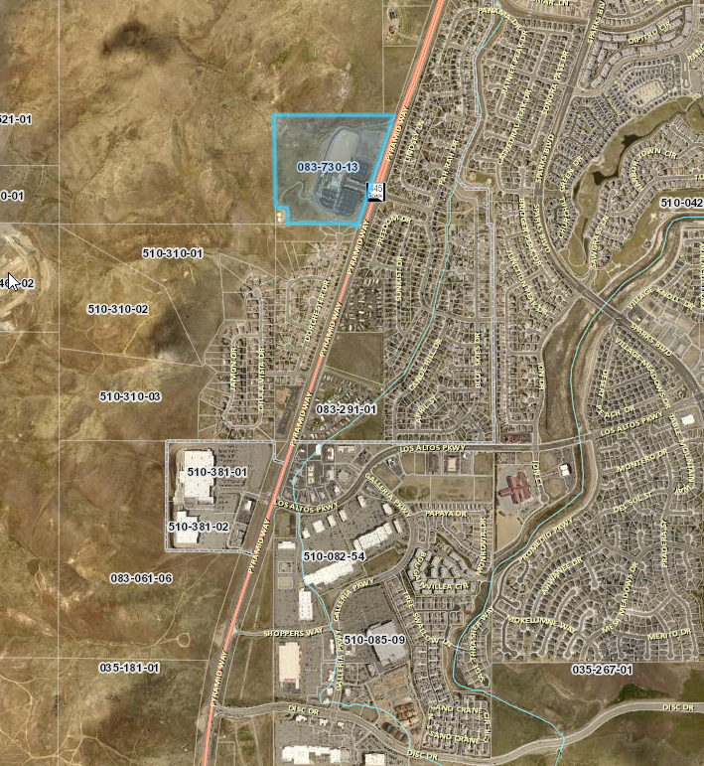

Slide 4
Background
There is an existing 33,064 sq. ft. church building on the site
The request is to add a 34,225 sq. ft. worship center and a 6,464 sq. ft. administrative building probably in the future
Also, an additional 309 parking spaces are to be added to the already existing 355 parking spaces
The site is flat and was previously graded under another permit

Slide 5
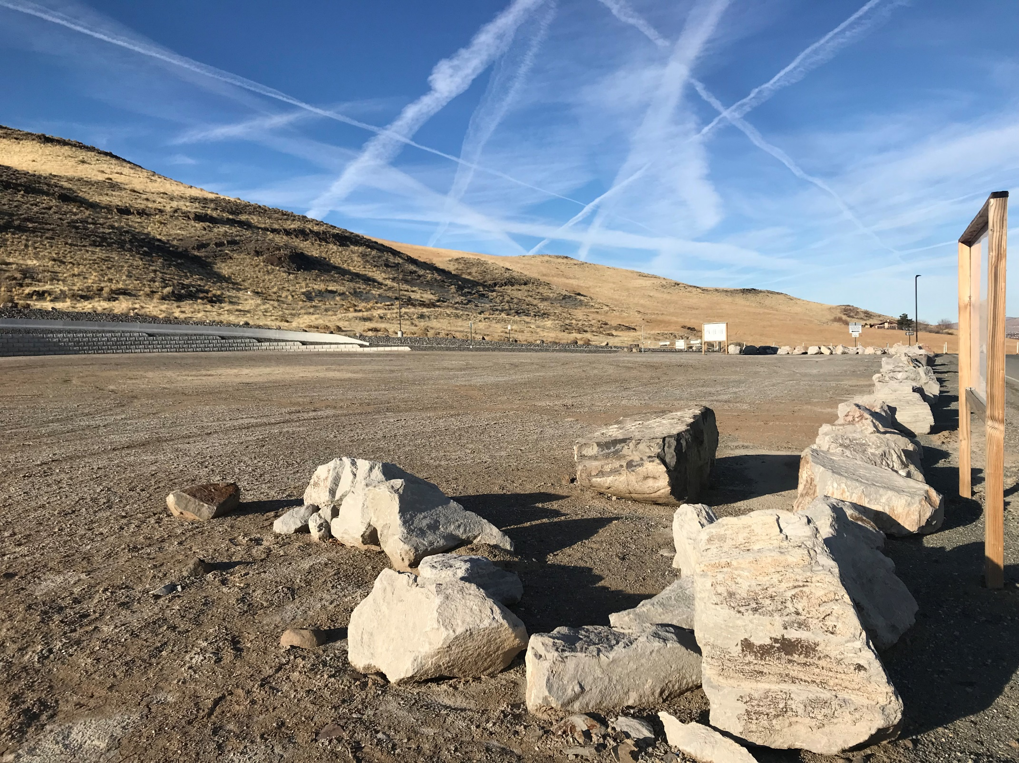
Looking northwest

Slide 6
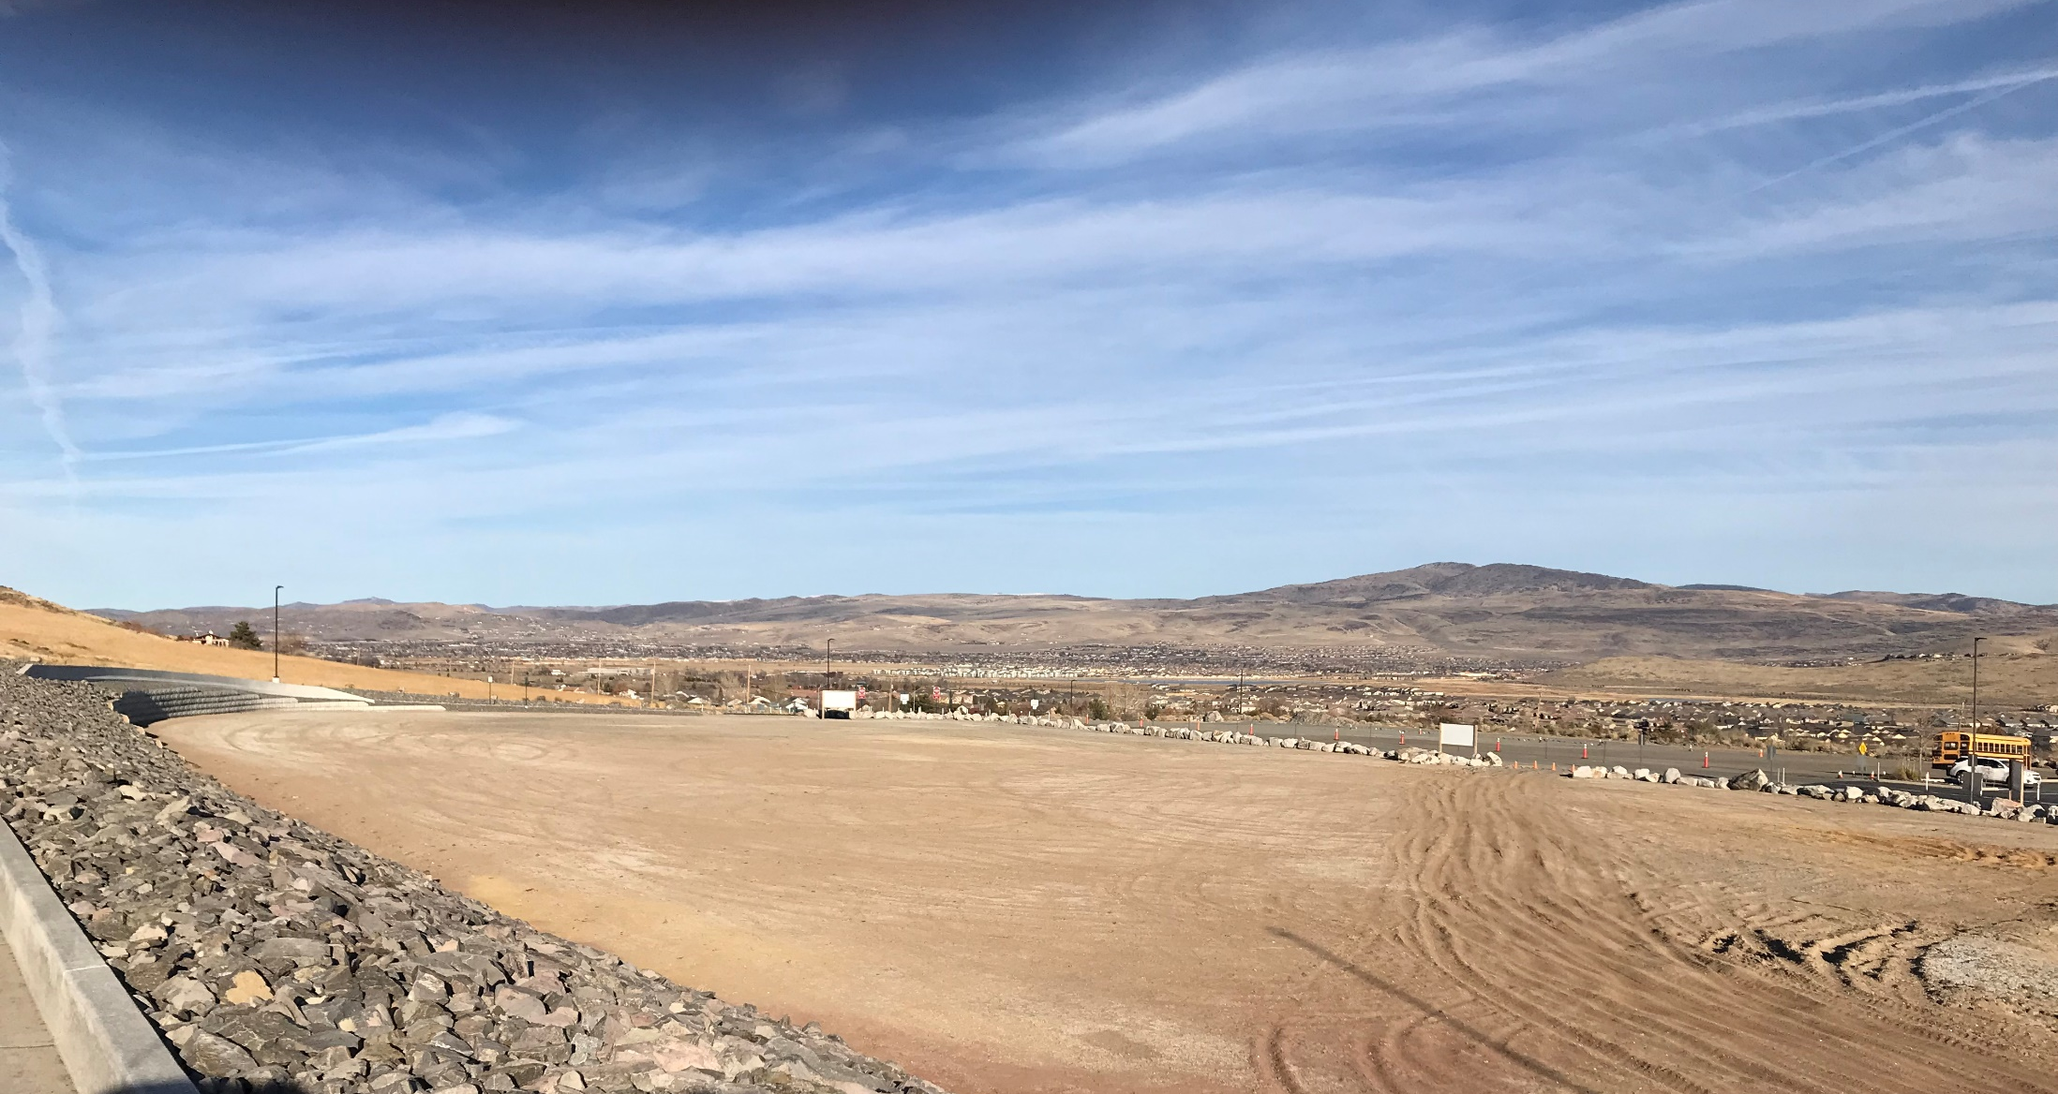
Looking northeast

Slide 7
Analysis
The applicant is requesting to graded 50,000 cubic yards of material -removingd 20,000 cubic yards from the property and 30,000 cubic yards will be place on the northern portion of the site as an earthen berm
The berm will be located on the northside of the property and will not exceed 6 feet in height

Slide 8
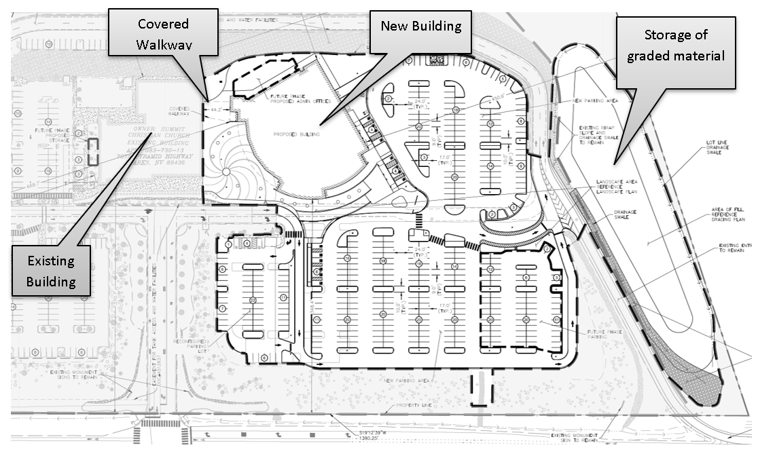
Site Layout

Slide 9
Amended NDOT Conditions
a.The proposed Pyramid Highway striping improvements will require the applicant to apply for a NDOT occupancy permit. The NDOT District II Permits Office can be contacted at (775) 834-8330 for more information on obtaining NDOT occupancy permits.
b. Applicant shall incorporate the recommended Pyramid Highway striping improvements described in the Traffic Analysis by Solaegui Engineers and reviewed by NDOT per the acceptance letter dated April 6th, 2020. A traffic analysis is typically valid for one year following the date on the acceptance letter, provided the nature of the development does not significantly change. If the project scope changes or is delayed, an updated traffic analysis will need to be submitted to NDOT for review.

Slide 10
Public Notice & CAB
Public notices were sent to parcels within 500 feet from the site
The Spanish Springs CAB met on January 8th and had the following comments concerning:
  Traffic
  Grading material
  Size of building
  Hours of operation
No correspondences or phone calls were received concerning the application

Slide 11
Reviewing Agencies
The application was distributed to various agencies for reviewed and their comments are included in the staff report
Agencies with conditions are included in the Conditions of Approval

Slide 12
Special Us Permit Findings
1. Consistency;
2. Improvements;
3. Site Suitability;
Issuance Not Detrimental; and
Effect on a Military Installation
Staff is able to make all the required findings, as detailed in the staff report on Page 7-8

Slide 13
Possible Motion
I move that, after giving reasoned consideration to the information contained in the staff report and information received during the public hearing, the Washoe County Board of Adjustment approve with amended conditions Special Use Permit Case Number WSUP19-0029 for Summit Christian Church, having made all five findings in accordance with Washoe County Code Section 110.810.30

